Slide 1
Lesson 1: Data Visualization Fundamentals
Andrew Graves
Data Dojo @ University of Pittsburgh
Jan 31, 2018

Slide 2

Overview
What is data visualization?
Why is it important?
When do we need it?
Where can we create it?
How do we optimize it?

Slide 3
What is data visualization?

Slide 4
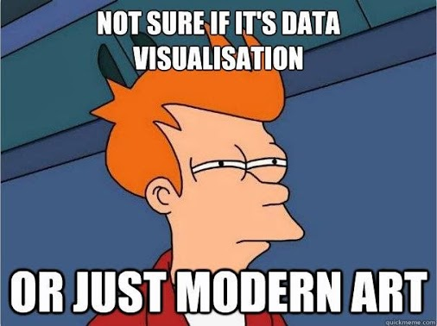
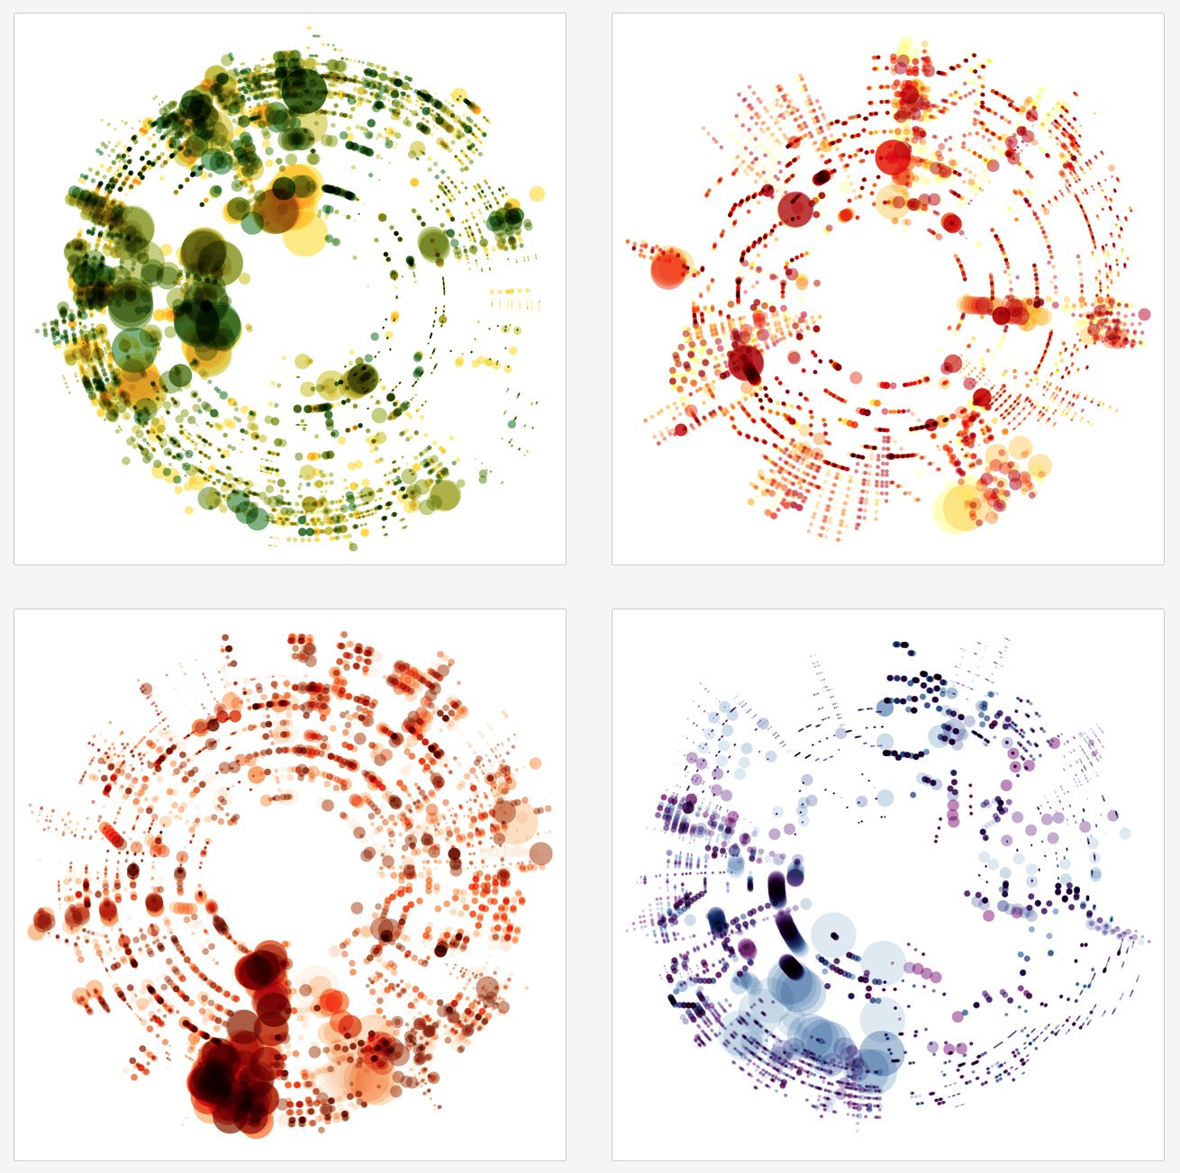
“…the visual display of quantitative information.“
Credit: Nichlas Rougeux -->
Twitter: @rougeux
Notes:
It’s Vivaldi’s Le Quattro Stagioni! Color is instrument, size is note length, and distance from the center is pitch. Read clockwise for each song.

Slide 5
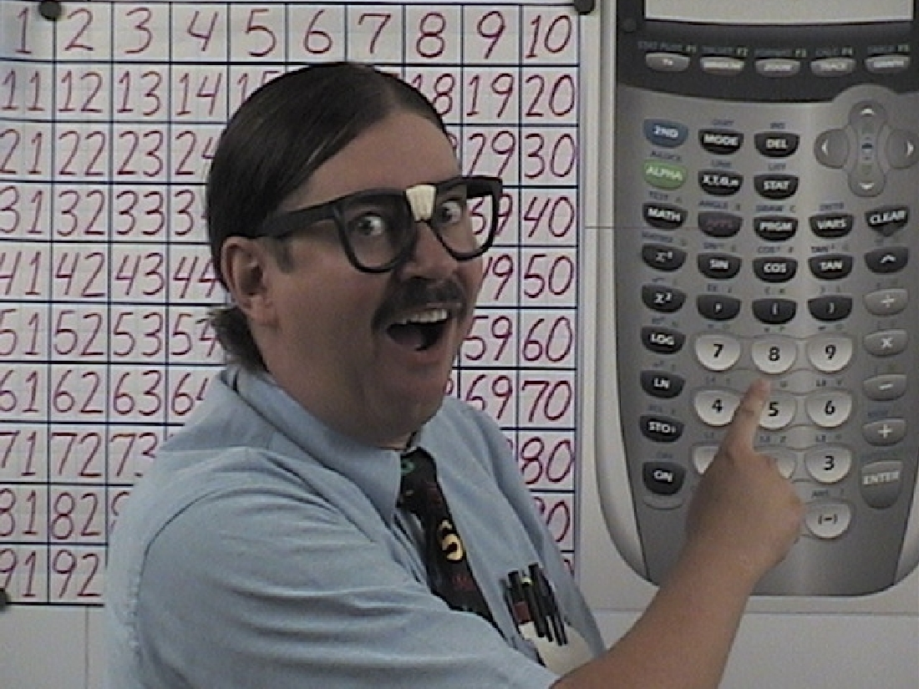
Why visualize at all?
Just show me the numbers!

Slide 6
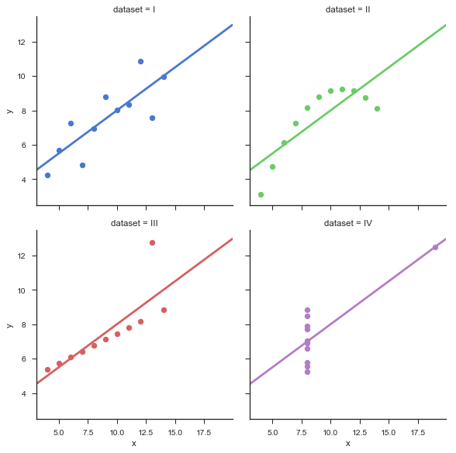
Not just purdy pics!
FUNCTIONAL
Efficient with space and time
Effectively communicates
Helps discover insights not evident with summary stats
Anscombe’s Quartet

Slide 7

When do we need it?

Slide 8

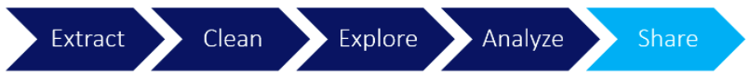
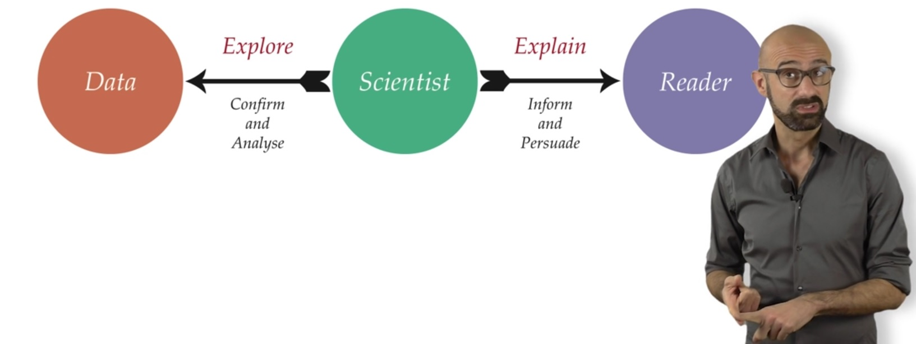
Twice in the Workflow!
Credit: udacity.com / datacamp.com

Slide 9

Where can we create visualizations?

Slide 10
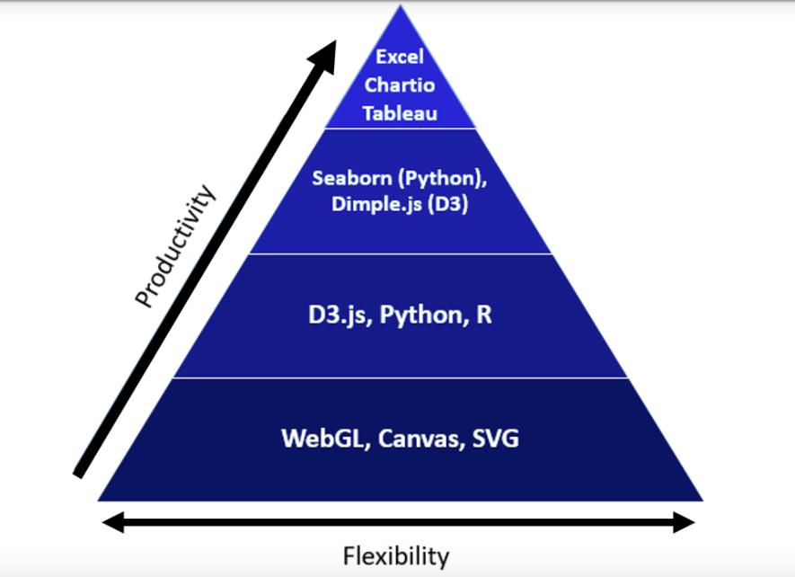
Credit: udacity.com

Slide 11
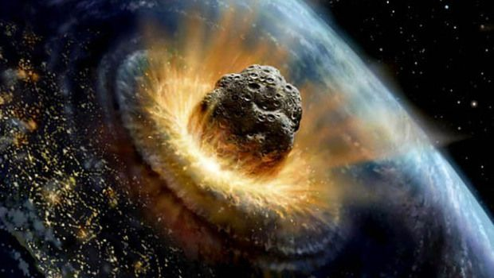
How can we create the biggest impact?

Slide 12

With knowledge of…
Data Types
Visual Encoding
The human mind…

Slide 13
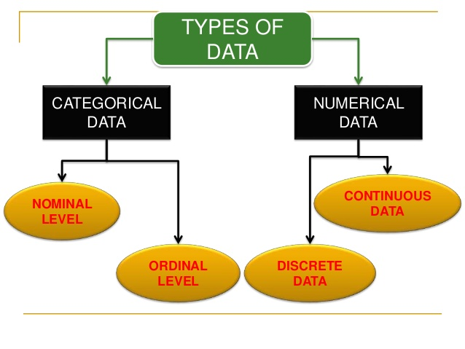
Credit: Saurabh Patni

Slide 14
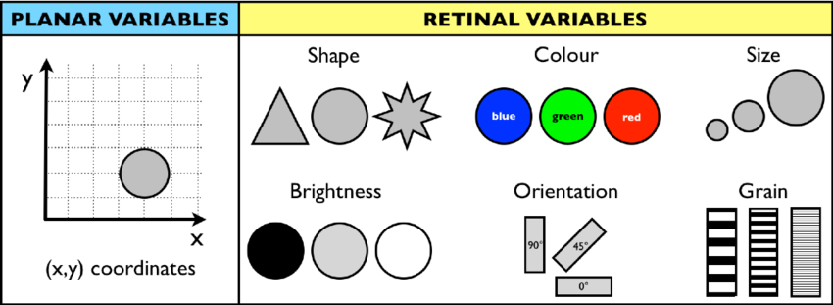
Visual Encoding: Mapping Data --> Display
PLANAR
Good for TWO variables
Includes bar and histograms!
RETINAL
Used for THREE variables and beyond
Credit: Daniel Amyot

Slide 15
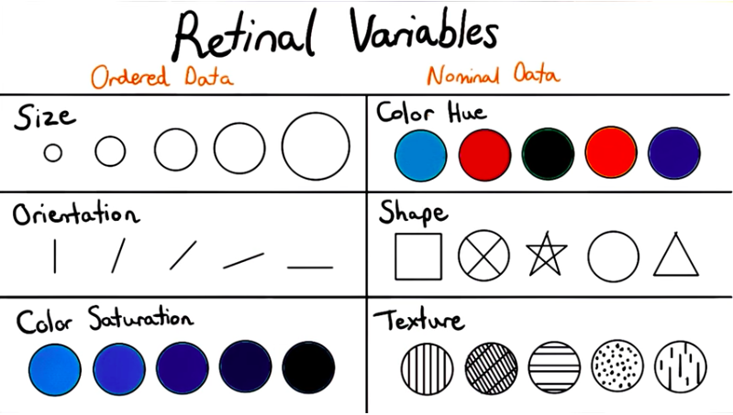
Credit: udacity.com

Slide 16
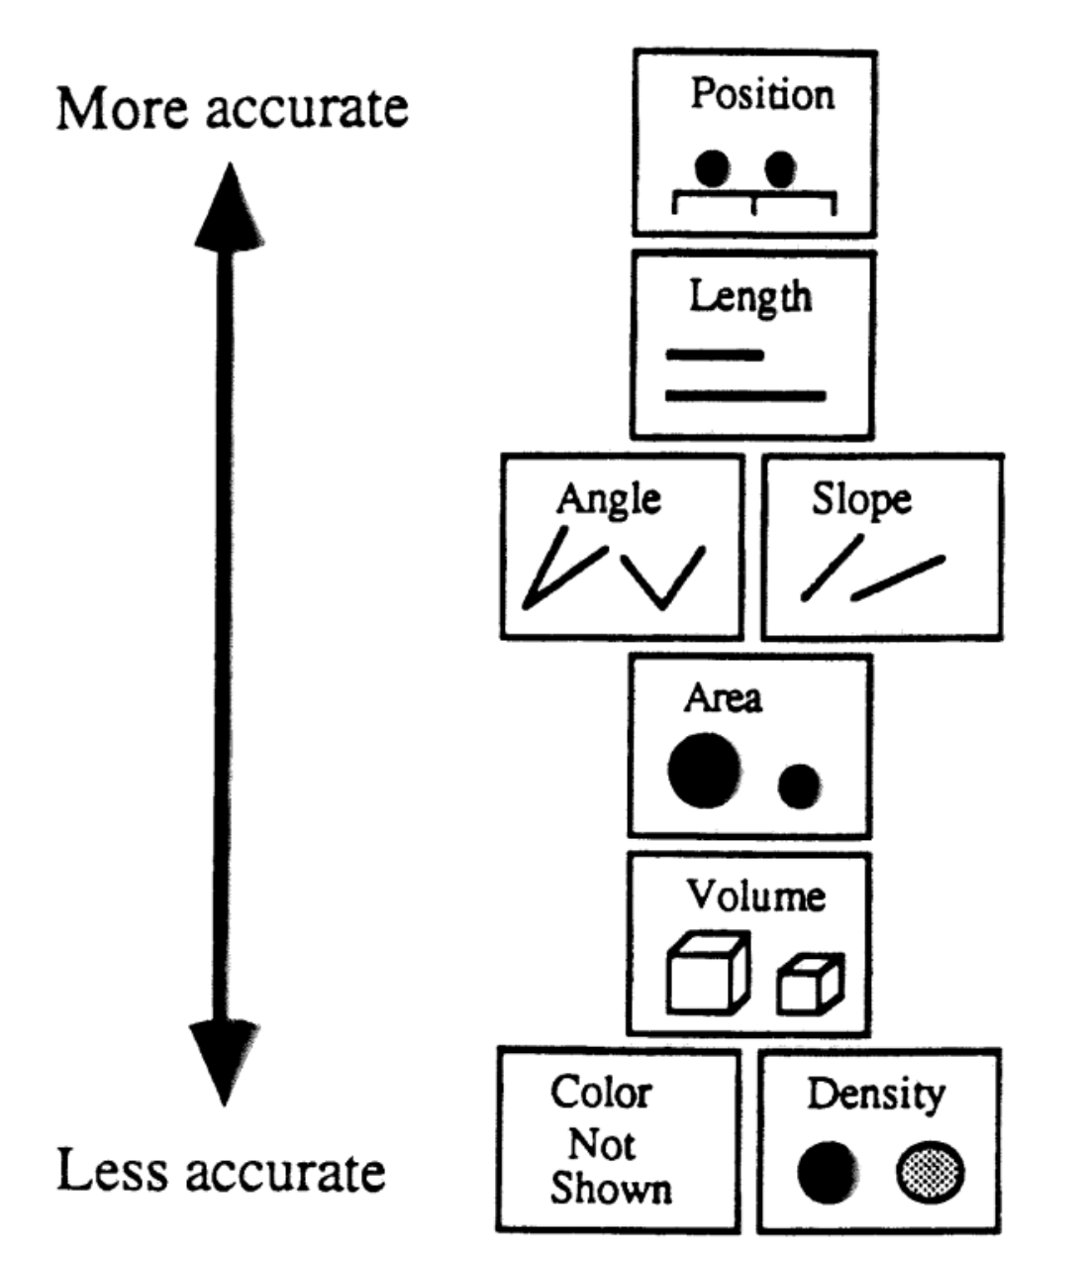
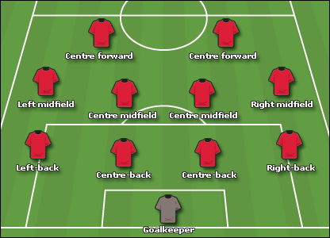

Graphical Perception: Theory, Experimentation, and Application…
Cleveland and McGill, 1985

Slide 17
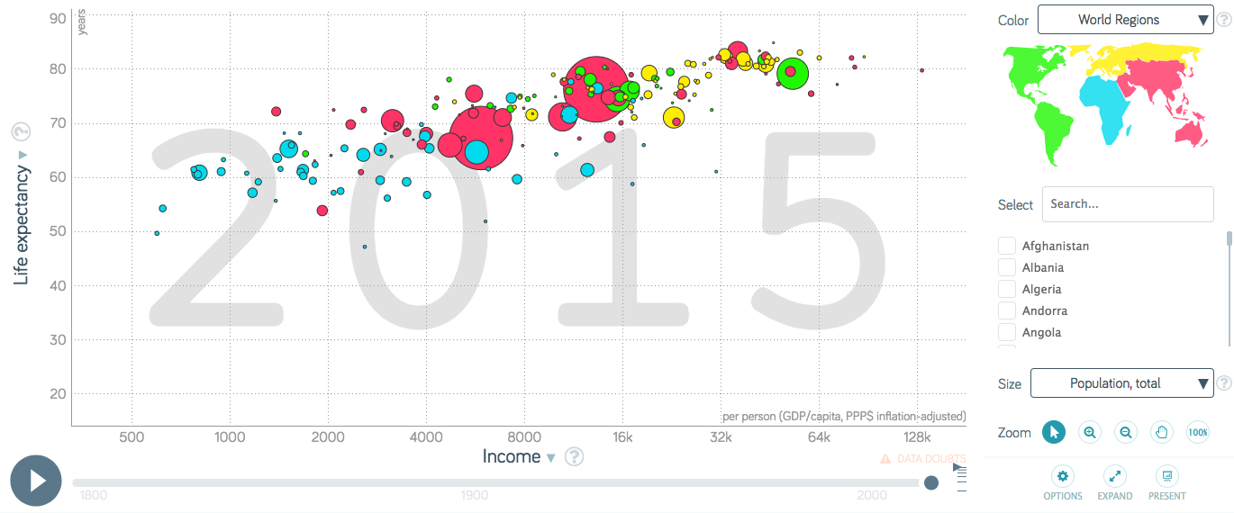
QUIZ: How are the variables encoded here?
Credit: gapminder.org

Slide 18

Key Take-Aways
Data Visualization: “The visual display of quantitative information”
WHY?
Efficient with time / space
Effective communication
Illuminates hidden patterns
WHEN?
Explore and Explain data
WHERE?
Many options - choose speed or flexibility
HOW?
Know your data types
Choose your visual encoders wisely

Slide 19
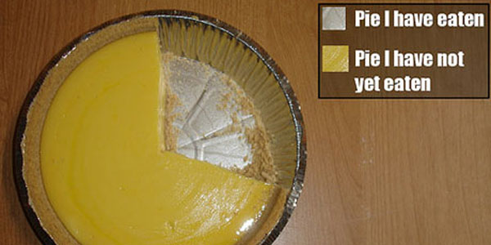
Any Questions / Comments?

Slide 20
Thank You
Andrew Graves
awgraves.github.io

Slide 21
Image Sources 1/2
https://www.targetopenday.co.uk/images/2015/ContentImages/FAQs-who-what-where-when.jpg
https://i.pinimg.com/originals/fb/be/25/fbbe2576cd7d8c39b120071248875bad.jpg
https://twitter.com/rougeux/status/771131859107471360
https://www.fwweekly.com/wp-content/uploads/2013/06/Math-Nerd.jpg
https://i.imgur.com/88WQFXx.jpg
https://www.class-central.com/report/app/uploads/2017/03/scavetta.jpg
https://i.pinimg.com/564x/9b/a2/da/9ba2da85c96ee794d54b281048c7bb16--art-jokes-manatees.jpg
http://marcvaneynde.com/wp-content/uploads/2014/06/skydive-laptop.jpg
https://seaborn.pydata.org/_images/anscombes_quartet.png

Slide 22
Image Sources 2/2
http://i.dailymail.co.uk/i/pix/2015/08/21/01/2B882C6600000578-0-image-a-37_1440115442305.jpg
https://usatunofficial.files.wordpress.com/2011/11/asteroidimpact_crop2.jpg?w=620&h=350&crop=1
http://i.dailymail.co.uk/i/pix/2015/08/21/01/2B882C6600000578-0-image-a-37_1440115442305.jpg
https://image.slidesharecdn.com/module1-140902011823-phpapp02/95/what-is-data-in-statistics-24-638.jpg?cb=1409620781
https://www.researchgate.net/profile/Daniel_Amyot2/publication/221055397/figure/fig1/AS:367506981179399@1464631900994/Fig-1-The-8-visual-variables-from-Bertin-18.png
http://newsimg.bbc.co.uk/media/images/41705000/gif/_41705404_4_4_2_416.gif
https://images.techhive.com/images/article/2015/02/keys-primary-100568747-large.jpg
http://infosthetics.com/archives/funny_pie_chart.jpg

